Slide 1

FINANCIAL ANALYSIS AMAZON,INC.
BY
ABHISHEK GUNDALA (11045013)
TRILOK DHANEKULA (11045003)

Slide 2
TABLE OF CONTENTS
1
2
3
4
5
6
BUSINESS OVERVIEW
FINANCIAL ANALYSIS
SWOT ANALYSIS & PORTER’S FIVE FORCES
INDUSTRY&
COMPETITIVE POSITIONING
VALUATION
RECOMMENDATIONS & CONCLUSION

Slide 3


BUSINESS DESCRIPTION
Initially established in Washington as an online bookstore in 1994, Amazon relocated its incorporation to Delaware in 1996. During its formative years, the company enhanced its online retail operations by acquiring several internet firms, such as Bookpages, Telebook, and IMDb in 1998.
ATTRIBUTES | INFORMATION
FOUNDED | 1994
FOUNDER | JEFF BEZOS
HEADQUATERS | SEATTLE,WA,USA
INDUSTRIES | E-COMMERCE, CLOUD COMPUTING
SERVICES | AMAZON PRIME, AWS,KINDLE
REVENUE | $386 BILLION
BUSINESS MODEL:
Global E-Commerce Leader
Amazon Prime
Amazon Web Services(AWS)
Digital Streamining and AI Technology
Physical And Online Intergration

Slide 4
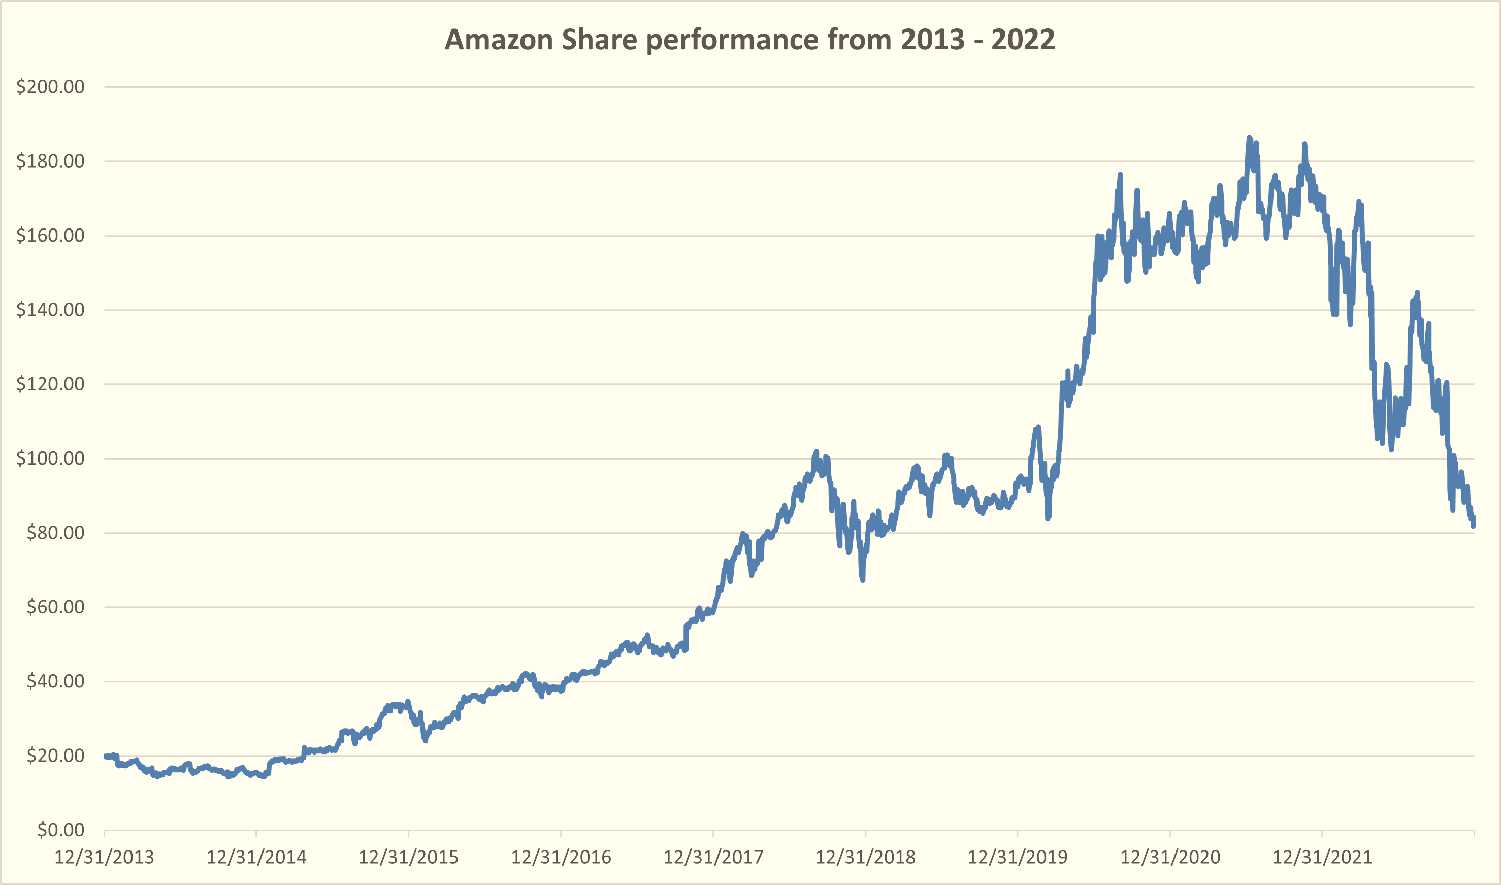
STOCK PERFORMANCE OF AMAZON (2013-2022)
Stock Peak: All-time high of $186.12 on July 8, 2021.
Revenue Growth: Reached $574.785 billion in 2023, up 11.83% YOY.
E-commerce Surge: Sales up over 320% from 2014 to 2022.
AWS Impact: Major contributor to operating income.
Market Dominance: Innovations like Prime and fast delivery.
Cloud Leadership: AWS's success in cloud computing.
Strategic Acquisitions: Expanding into grocery and smart home tech.
Regulatory Navigation: Addressing antitrust and labor concerns.
External Factors: Economic conditions and market sentiment influence

Slide 5
FINANCIAL ANALYSIS
1.Revenue Growth
- Revenues up from $74B in 2013 to $514B in 2022
- Indicates business expansion and market dominance
2.Profit Margins
- Gross margin improved from 27.23% to 43.81%
- Demonstrates better cost controls and efficiency
3.Operating Expenses
- Increasing R&D expenses (Percent of revenue)
- Rising SG&A expenses (Percent of revenue)
- Shows focus on innovation and long-term growth
4.Operating Income
- Overall upward trajectory
- Success in translating growth into profits

Slide 6
ROA % (Net):
High: 4.94% in 2015
Low: -0.62% in 2022
ROE % (Net):
Peak: 28.27% in 2018
Negative: -1.91% in 2022
ROI % (Operating):
Maximum: 21.68% in 2020
EBITDA Margin %:
High in 2016: 14.45%
Low in 2022: 3.96%
Revenue per Employee:
Decrease from $634,714 in 2013 to $333,539 in 2022

Slide 7
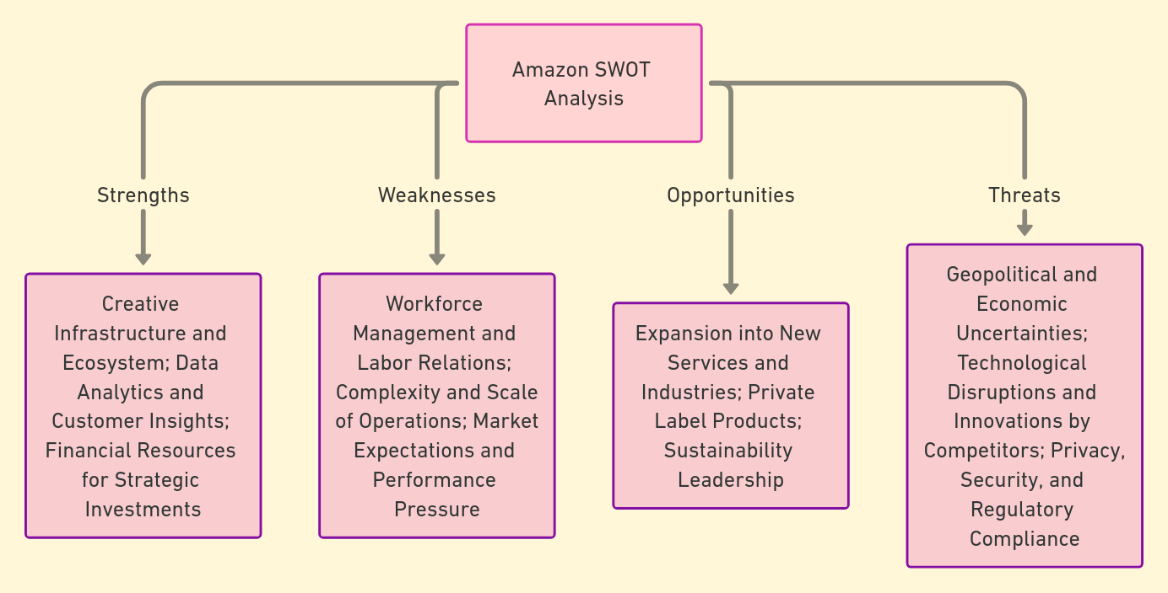
SWOT ANALYSIS

Slide 8
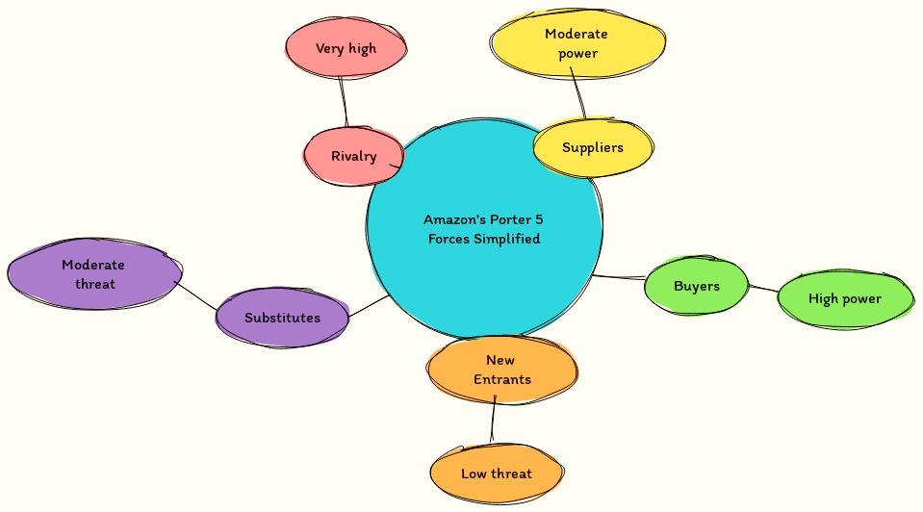
PORTER’S FIVE FORCES
Suppliers: Moderate Power
Many suppliers, easy to switch, unique products increase power.
Buyers: High Power
Many alternatives, price-sensitive, Amazon competes with pricing and service.
New Entrants: Low Threat
High barriers to entry, Amazon's scale deters competitors, niche markets vulnerable.
Substitutes: Moderate Threat
Diverse offerings reduce threat, convenience of Amazon's platform.
Rivalry: Very High Intense
competition, Amazon leads with innovation and customer focus.

Slide 9

COMPETITVE ANALYSIS
Massive scale and infrastructure - Vast fulfillment infrastructure enables highly efficient operations at low cost
First mover advantage - Early innovation established strong brand, habits and leadership in ecommerce/cloud
Low prices - Leverages scale efficiencies to offer unmatched value and undercut competitors
Prime loyalty program - Provides benefits that drive subscription revenue and foster customer retention
Diverse business lines - Multiple revenue streams allow investment and innovation across retail, cloud, content
Customer obsession - Laser focus on customer experience, selection, convenience and speed sets Amazon apart

Slide 10
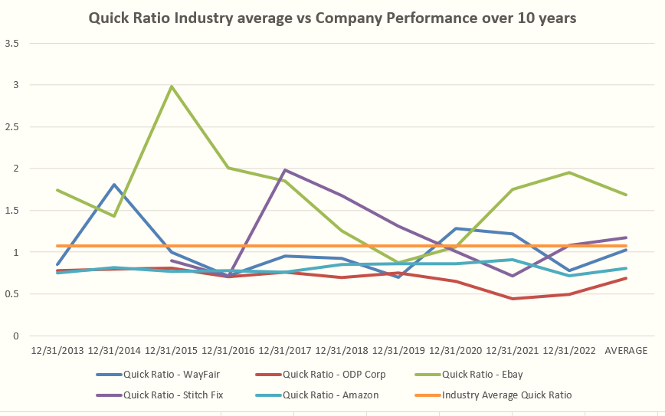
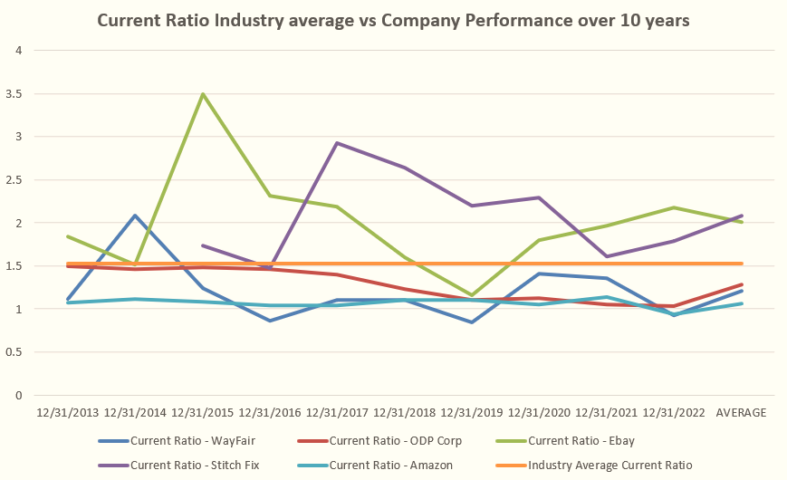
Market Leadership - Amazon dominates market share with over 50% of US ecommerce and continues aggressive expansion in new sectors.
Operational Scale - Amazon's distribution network and technological capabilities drive efficiencies. However, declines seen recently in asset turns.
Profitability Outperformance - Amazon generates 3x more net income on average than competitors, with margins expanding over time.
Growth Trajectory - Competitors like Wayfair and StitchFix show potential but small fraction of Amazon's size. ODP struggling.
Strategic Innovation - Amazon invests billions in transforming customer experience and new tech like AI. Competitors lag significantly.

Slide 11
DISCOUNTED CASH FLOW MODEL
Financial Summary
Enterprise Value (EV): Stands at $1.91 Trillion, representing the total valuation of the company including both debt and equity.
EV/Share: Calculated to be $186.72, indicating the enterprise value attributed to each outstanding share.
Net Debt: Amounts to $70.78 Billion, showing the company's debt after subtracting cash and cash equivalents.
Equity Value: Valued at $1.84 Trillion, representing the shareholders' interest in the company after debts.
Projected Stock Price: Forecasted at $179.81 per share, based on expected future cash flows.
SCALE IN THOUSANDS
Enterprise Value | $1,912,405,792.35
EV/share | $186.72
Net Debt | $70,787,993.38
Equity Value | $1,841,617,798.97
Projected Stock Price | $179.81
TERMINAL VALUE | $4,571,744,607,362
Enterprise Value of Amazon | $1,912,405,792,350

Slide 12
RELATIVE VALUATION
AMAZON
 | Cap Based on AVG | Price per share
P/E (forward or last earnings) | $ 1,721,733,791.80 | $ 168.11
EBITDA multiplier | $ 900,875,415.54 | $ 87.96
Sales multiplier | $ 514,876,432.09 | $ 50.27
Book Value multiplier | $ 186,702,026.47 | $ 18.23
 | Average | $ 81.14

Slide 13
RECOMMENDATIONS & CONCLUSION
$179
HOLD?
BUY?
SELL
BUY?
HOLD?
HOLD!!
SELL?

Slide 14
THANK YOU!!!

